Slide 1

Good Reads – What Makes a Bestseller?
Analysis of a dataset for insights on bestselling books on Amazon (2009-2019)
Deepika Gowda
1/24/2022

Slide 2



Data Set Overview and Exploration
2009-2019 dataset of best-selling books on Amazon
  Dataset obtained from Kaggle with information on book name, author, genre, reader rating, & price
Data set cleaning and curation
  Checked for missing values, Across years sales and ratings were cumulated/averaged
Final Dataset
  351 different books (fiction, non-fiction) by 248 authors

Slide 3
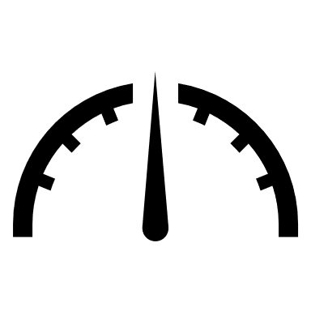


Statistical Methodology and Correlation Analysis
Data analytics conducted using Python
  Descriptive stats (n, average, median, range, SD, min, max)
Visualization generated with Python graphical libraries
Data set tested for central tendency/distribution, median inference, and correlations
  Price/rating; author/rating; genre/rating

Slide 4

Insights

Slide 5
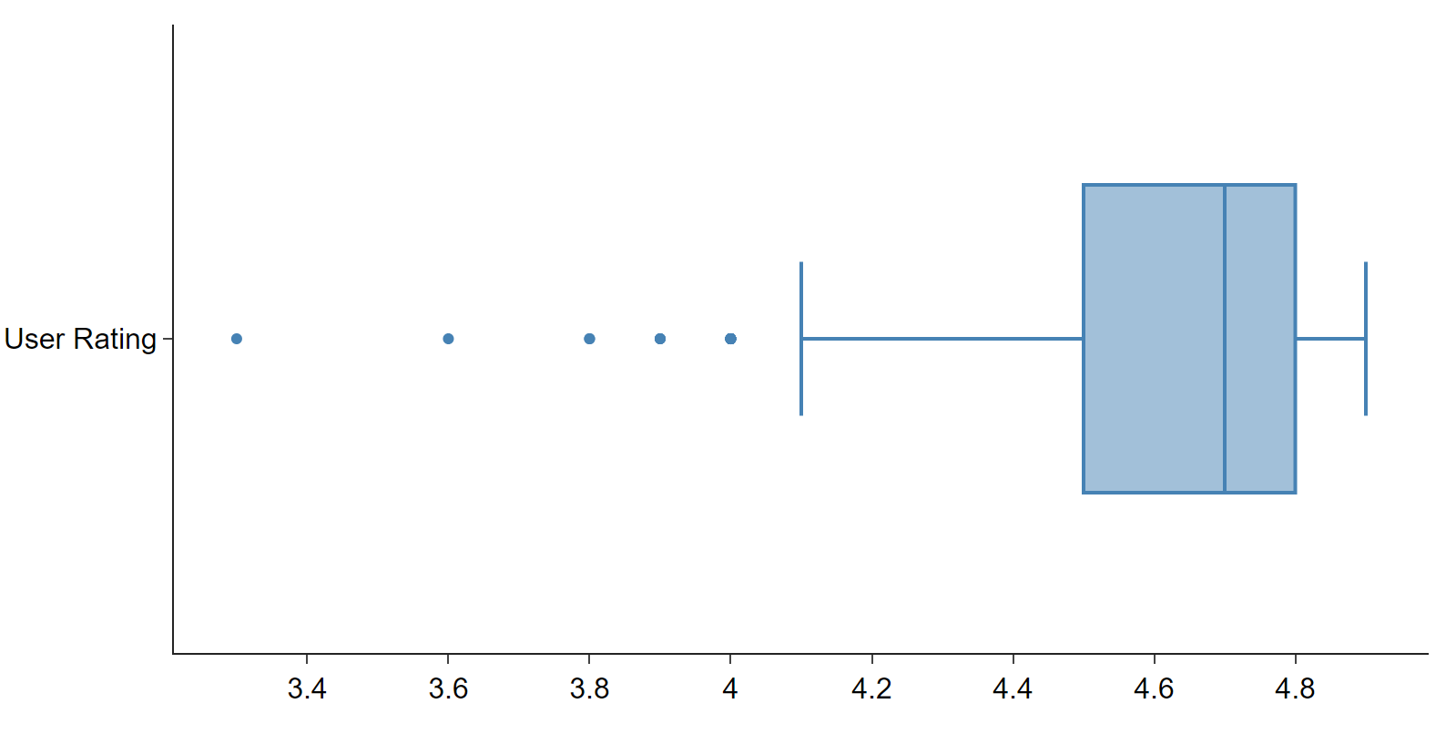
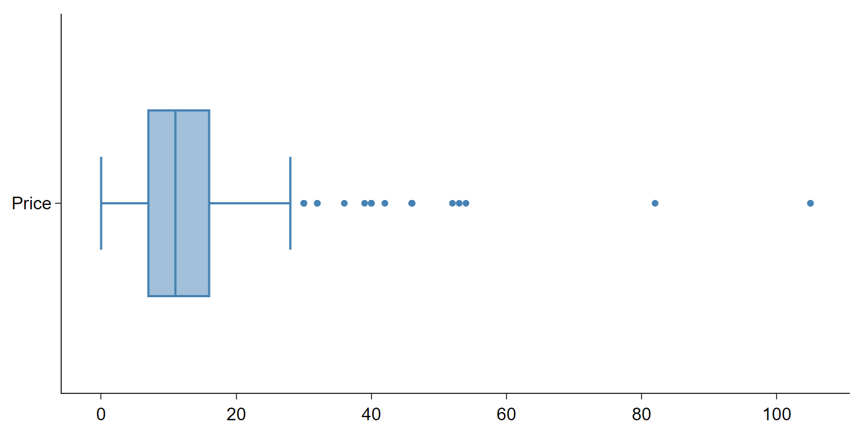
Data Asymmetry (skewed, non-normal distrib.) in User Ratings and Price; This Gives Critical Insights
Readers in general tend to inflate the quality of their reads (median rating is 4.7 on 5.0). Also, pricing is a critical component in the book-selling business. The bestsellers were predominantly priced between $7-$16.

Slide 6
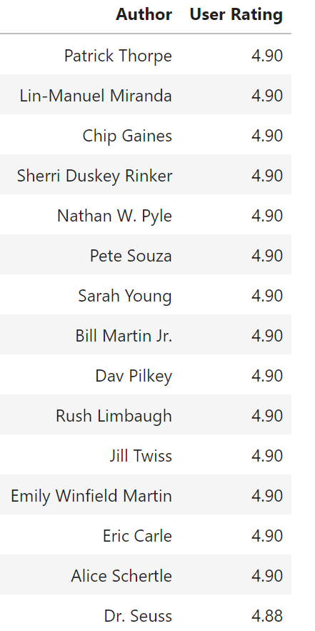
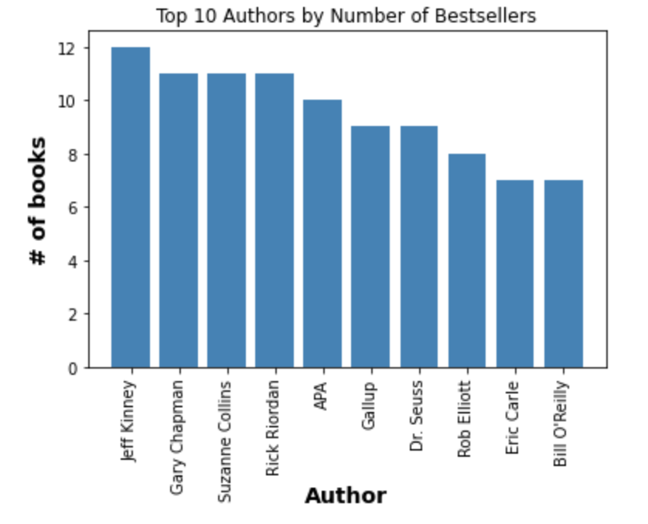
Being a celebrity, television personality or an author of children/young reader books is a good predictor…for both high ratings and serial outputs

Slide 7
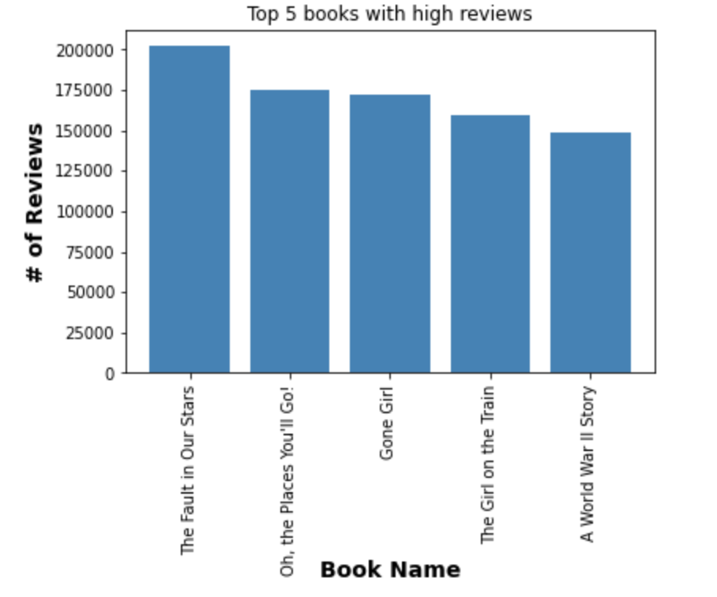
Readers (by the thousands) are passionate about sharing their experiences on good reads
The Fault in Our Stars (John Green, 201,928 reviews) is a book inspired by Shakespeare’s Julius Caesar. It takes the reader through the lives of two teenage cancer patients who share a common bond through novels, wit and life values.
Oh, the places you’ll go! (Dr. Seuss; 174,672 reviews). A Children’s Classic on the joy of life and what to expect as kids get older while remembering to be grateful, thankful, ambitious and kind.

Slide 8
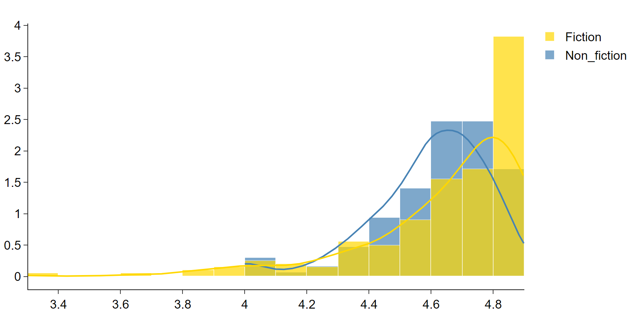
Reader ratings may be influenced by the Genre of their reads
Users evaluate books differently based on genre; based on median values, readers rated works of fiction (4.7) higher than non-fiction(4.6) reads.

Slide 9
Thank you

